Slide 1

DISCRETE MATHEMATICS
Chapter 2:
LOGIC
Presenter: Ph.D. Phu-Nguyen Le
June 7th, 2023
1

Slide 2
Chapter 2
2.1. PROPOSITIONAL LOGIC.
2.1.1. Definition.
2.1.2. Operations.
2.1.3. Rules of deduction
2.2. PREDICATE LOGIC.
2.2.1. Definition
2.2.2. Amount of words
2.2.3. Rules of inference with word quantity
2

Slide 3
Chapter 2
2.3. PROOF.
2.3.1. Prove directly
2.3.2. Indirect proof
3

Slide 4
2.1 PROPOSITIONAL LOGIC.
2.1.1 Definition.
Logic: (from the Greek) is the formal systematic study of the principles of valid inference and correct reasoning
What does logic use for?
Mathematical reasoning
Computer science:
Building programs
Testing program
Artificial intelligence
4
Notes:
Là một nhánh của triết học và toán học nghiên cứu về nguyên tắc, phương pháp và tiêu chuẩn hình thức cho sự hợp lệ của suy luận, và kiến thức
Logic (from the Greek) is the formal systematic study (sự nghiên cứu có tính hệ thống) of the principles (quy tắc) of valid inference and correct reasoning (lập luận có căn cứ và suy luận đúng)

Slide 5
2.1 PROPOSITIONAL LOGIC.
2.1.1 Definition.
Proposition: a sentence that expresses an idea about how something is
Example: It’s going to rain tomorrow
Statements fall into three categories:
    Statements we know to be true because we can prove them—theorems.
    Statements whose truth we cannot ascertain—conjectures.
    Statements that are false—mistakes!
Team works: Give examples about statement
5

Slide 6
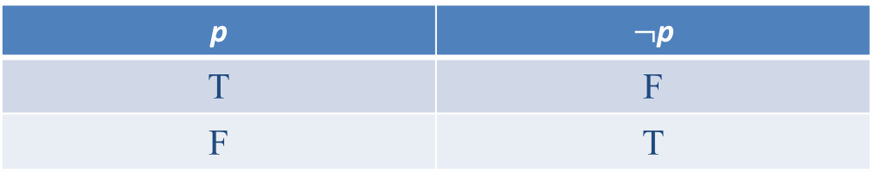
2.1 PROPOSITIONAL LOGIC.
2.1.1 Definition.
p,q,r for statement notations
A statements is True, T
A statements is False, F
A truth table represents the relationship between the truth values of propositions
Example:
A compound proposition is formed by combining existing propositions with logical operators.
p | $¬$p
T | F
F | T
6

Slide 7
2.1 PROPOSITIONAL LOGIC.
2.1.2. Operations.
Assume that p, q are statements
  ¬p: negation
  p ∧ q: conjunction
  p ∨ q: disjunction
  p ⊕ q: exclusive-OR
  p → q: implication
  p ↔ q: bi-implications
7
Notes:
Giả thiết p,q là mệnh đề ☞ ¬p: phủ định (negation) ☞ p ∧ q: toán tử hội (conjunction) ☞ p ∨ q: toán tử tuyển (disjunction) ☞ p ⊕ q: toán tử tuyển loại (exclusive-OR) ☞ p → q: toán tử kéo theo (implication)

Slide 8
2.1 PROPOSITIONAL LOGIC.
2.1.2. Operations.
p | q | ¬p | p ∧ q | p ∨ q | p ⊕ q | p → q (p ⸧ q) | p ↔ q
T | T | F | T | T | F | T | T
T | F | F | F | T | T | F | F
F | T | T | F | T | T | T | F
F | F | T | F | F | F | T | T
8
Notes:
. Câu “Nếu A thì B” trong tiếng Việt thường biểu thị một mối liên hệ giữa A và B về nội dung. Chẳng hạn, A là điều kiện, B là hệ quả (vì vậy mệnh đề loại này còn được gọi là mệnh đề điều kiện), hay A là nguyên nhân, B là kết quả. Nhưng trong logic mệnh đề chúng ta không quan tâm đến mối liên hệ về mặt nội dung đó, mà chỉ quan tâm đến mối liên hệ về giá trị chân lý của chúng mà thôi. Cụ thể là ta sẽ coi là “Nếu A thì B” chỉ sai khi A đúng mà B sai. Trong tất cả các trường hợp khác “Nếu A thì B” đúng.
Noi cach khac Chỉ sai khi giả thiết (hypothesis) p là đúng nhưng kết luận (conclusion) q là sai

Slide 9
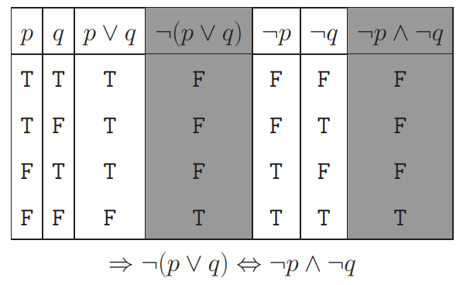
2.1 PROPOSITIONAL LOGIC.
2.1.2. Operations.
The combined propositions are called 'equivalent logic' if they have the same truth table
9
Notes:
p → q ☞ q → p được gọi là mệnh đề đảo (converse) ☞ ¬q → ¬p được gọi là mệnh đề phản đảo (contrapositive)

Slide 10
2.1 PROPOSITIONAL LOGIC.
2.1.2. Operations.
p ∧ T ⇔ p p ∨ F ⇔ p | Identity laws | p ∨ q ⇔ q ∨ p p ∧ q ⇔ q ∧ p | Commutative laws
p ∨ T ⇔ T p ∧ F ⇔ F | Domination laws | (p ∨ q) ∨ r ⇔ p ∨ (q ∨ r) (p ∧ q) ∧ r ⇔ p ∧ (q ∧ r) | Associative laws
p ∨ p ⇔ p p ∧ p ⇔ p | Idempotent laws | p ∨ (q ∧ r) ⇔ (p ∨ q) ∧ (p ∨ r) p ∧ (q ∨ r) ⇔ (p ∧ q) ∨ (p ∧ r) | Distribute laws
¬(¬p) ⇔ p | Double negation law | ¬(p ∧ q) ⇔ ¬p ∨ ¬q ¬(p ∨ q) ⇔ ¬p ∧ ¬q | De Morgan’s laws
10

Slide 11
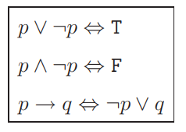
2.1 PROPOSITIONAL LOGIC.
2.1.2. Operations.
Proof : ¬(p ∨ (¬p ∧ q)) ⇔ ¬p ∧ ¬q
11

Slide 12
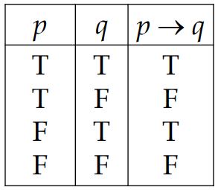
2.1 PROPOSITIONAL LOGIC.
2.1.3. Rules of deduction(implication)
Given p → q
  p: (hypothesis).
  q: (conclusion).
  What does this mean?
    If …then
12

Slide 13
2.1 PROPOSITIONAL LOGIC.
2.1.3. Rules of deduction(implication)
Give Examples?
13

Slide 14
2.1 PROPOSITIONAL LOGIC.
2.1.3. Rules of deduction(implication)
Why does r = p → q =True → Fales is False
  Hypothesis p is true
  Conclusion q is false
p → q
  q → p (converse)
  ¬q → ¬p (contrapositive)
Give Examples?
14
Notes:
p → q ☞ q → p được gọi là mệnh đề đảo (converse) ☞ ¬q → ¬p được gọi là mệnh đề phản đảo (contrapositive)

Slide 15
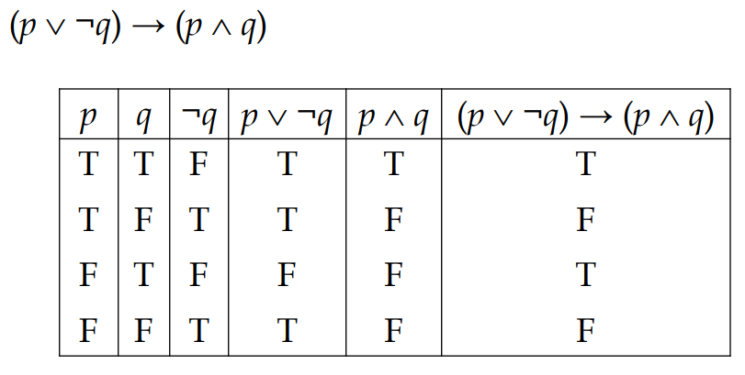
2.1 PROPOSITIONAL LOGIC.
2.1.3. Rules of deduction(implication)
15
Notes:
p → q ☞ q → p được gọi là mệnh đề đảo (converse) ☞ ¬q → ¬p được gọi là mệnh đề phản đảo (contrapositive)

Slide 16

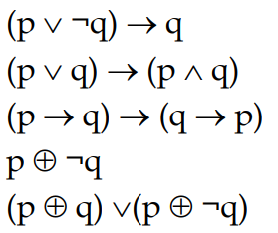
2.1 PROPOSITIONAL LOGIC.
2.1.3. Rules of deduction(implication)
Prove:
Truth table for:
16

Slide 17
2.2 PREDICATE LOGIC.
2.2.1. Definition:
Why do we use predicate logic?
Constructing inference chains or proofs in propositional logic, the logic itself does not consider the internal structure.
For example,
p="All birds can fly,"
we can symbolize this proposition with a letter, say p, and then treat p as having no internal structure.
This means that we do not investigate the internal structure of p and, of course, do not use any information contained in that structure.
However, there are certain inferences that necessitate the use of the internal structure of propositions.
17

Slide 18
2.2 PREDICATE LOGIC.
2.2.1. Definition:
For example,
p="All birds can fly,"
q= “Eagles are bird"
There is no law to state: r= “a grey eagles can fly"
For example,
“x > 3”
“x”: Subject
“> 3”: Predicate
P(x): x > 3 (P is the predicate “more than 3”)
18

Slide 19
2.2 PREDICATE LOGIC.
2.2.1. Definition:
For example,
p="All birds can fly,"
q= “Eagles are bird"
There is no law to state: r= “a grey eagles can fly"
For example,
“x > 3”
“x”: Subject
“> 3”: Predicate
P(x): x > 3 (P is the predicate “more than 3”)
19

Slide 20
2.2 PREDICATE LOGIC.
2.2.1. Definition:
P(x): x > 3
P(4)=True
P(2)=False
P(x) is the proposition function of P at x
Q(x,y): x = y +3
Q(1,2)
Q(3,0)
20
Notes:
Predicate (vị từ) là một hàm mệnh đề mô tả thuộc tính của các đối tượng và mối quan hệ giữa chúng

Slide 21

2.2 PREDICATE LOGIC.
2.2.1. Definition:
Predicate is a proposition function that describes the attributes of objects and the relationships between them.
Statement “x > 1” is not a proposition.
How to make it to be a proposition?
1: 0 > 1.
2: $∃x∈N:$x > 1
$∀x∈N:$x > 1
21
Notes:
Predicate (vị từ) là một hàm mệnh đề mô tả thuộc tính của các đối tượng và mối quan hệ giữa chúng

Slide 22

2.2 PREDICATE LOGIC.
2.2.1. Definition:
Predicate is a proposition function that describes the attributes of objects and the relationships between them.
Statement “x > 1” is not a proposition.
How to make it to be a proposition?
1: 0 > 1.
2: $∃x∈N:$x > 1
$∀x∈N:$x > 1
Related to Amount
22

Slide 23

2.2 PREDICATE LOGIC.
2.2.2. Quantifier- Amount of word :
$∀$: for-all
∀xP(x) = “P(x) is T for all x”
∃ : exists (tồn tại)
∃xP(x) = “There exists x such that P(x) is T”
Domain
Image
23

Slide 24
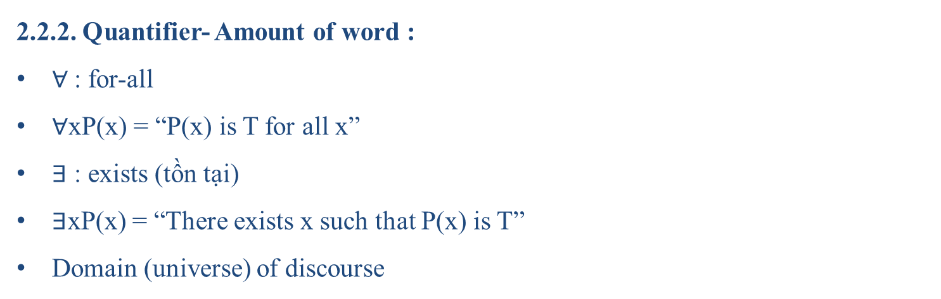
2.2 PREDICATE LOGIC.
2.2.2. Quantifier- Amount of word :
$∀$: for-all
∀xP(x) = “P(x) is T for all x”
∃ : exists (tồn tại)
∃xP(x) = “There exists x such that P(x) is T”
Domain (universe) of discourse
24
Notes:
Domain (universe) of discourse
la vu tru bien luan
Mien ma moi gia tri cua bien dung voi tinh chat nao do

Slide 25

2.2 PREDICATE LOGIC.
2.2.1. Quantifier- Amount of word :
Example 1: “All IT students must study discrete maths”
  $∀$P(x) = “x must study discrete maths”
  $∀$Proposition: $∀$xP(x)
For more details:
  S(x) = “x is an IT student”
  P(x) = “x must study discrete maths”
  Proposition: $∀$x(S(x) → P(x))
Today’s Big question: Why not $∀$x(S(x) ∧ P(x))?
25
Notes:
Domain (universe) of discourse
la vu tru bien luan
Mien ma moi gia tri cua bien dung voi tinh chat nao do

Slide 26

2.2 PREDICATE LOGIC.
2.2.2. Quantifier- Amount of word :
Example 2: P(x) = “x > 3”
  Domain: x $∈R$
  Proposition: ∃ xP(x) TRUE or FALSE?
Example 3: Q(x) = “x=x+ 1”
  Domain: x $∈R$
  Proposition: ∃xQ(x) TRUE or FALSE?
26
Notes:
Domain (universe) of discourse
la vu tru bien luan
Mien ma moi gia tri cua bien dung voi tinh chat nao do

Slide 27
2.2 PREDICATE LOGIC.
2.2.2. Quantifier- Amount of word :
Example 2: P(x) = “x > 3”
  Domain: x $∈R$
  Proposition: ∃ xP(x) TRUE or FALSE?
Example 3: Q(x) = “x=x+ 1”
  Domain: x $∈R$
  Proposition: ∃xQ(x) TRUE or FALSE?
27

Slide 28
2.2 PREDICATE LOGIC.
2.2.2. Quantifier- Amount of word :
∀xP(x) =P(x₁ ) ∧ P(x₂ ) ∧ . . . ∧ P(x_{n} )
∃xP(x) =P(x₁ ) ∨ P(x₂ ) ∨ . . . ∨ P(x_{n} )
How to determine that the statement is true or false?
  ∀: check for all xi to be true to determine the statement is true
  ∃ : find out a true xi to determine the statement is true
Order of Amount of word is importance (except ∀, ∃ )
  Left to right
  In to out
29

Slide 29
2.2 PREDICATE LOGIC.
2.2.3. Rules of inference with word quantity :
Modus Ponens (Rule of Detachment):
  If the proposition "A implies B" is true.
  And the proposition "A" is true.
  Then we can infer that "B" is true.
The hypothesis is true, then the conclusion is true
29

Slide 30
2.2 PREDICATE LOGIC.
2.2.3. Rules of inference with word quantity :
Modus Tollens (Rule of Contrapositive):
  If the proposition "A implies B" is true.
  And the proposition "not B" is true.
  Then we can infer that "not A" is true.
30

Slide 31
2.2 PREDICATE LOGIC.
2.2.3. Rules of inference with word quantity :
Hypothetical Syllogism:
  If the proposition "A implies B" is true.
  And the proposition "B implies C" is true.
  Then we can infer that "A implies C" is true.
31

Slide 32
2.2 PREDICATE LOGIC.
2.2.3. Rules of inference with word quantity :
Disjunctive Syllogism:
  If the proposition "A or B" is true.
  And the proposition "not A" is true.
  Then we can infer that "B" is true.
28

Slide 33
2.2 PREDICATE LOGIC.
2.2.3. Rules of inference with word quantity :
Simplification:
  If the proposition "A and B" is true.
  Then we can infer that "A" and "B" individually are true.
31

Slide 34
2.2 PREDICATE LOGIC.
2.2.3. Rules of inference with word quantity :
Conjunction:
  If the proposition "A" is true.
  And the proposition "B" is true.
  Then we can infer that "A and B" is true.
34

Slide 35
2.2 PREDICATE LOGIC.
2.2.3. Rules of inference with word quantity :
Addition:
  If the proposition "A" is true.
  Then we can infer that "A or B" is true.
35

Slide 36

2.3 PROOF
2.3.1. Prove directly proof
  What is a proof ?
  A proof is an essay that incontrovertibly shows that a statement is true.
Direct proof of an if-then theorem.
  Prove p $→$q
  Show: “If p is true then q have to be true”.
Example: “If n is an odd number then n² is an odd number”
  Proof: Assume that n is an odd number
  n = 2k + 1
  n² = (2k + 1)² = 4k² + 4k + 1 = 2(k²+2k) + 1 (odd number)
36

Slide 37

2.3 PROOF
2.3.2. Prove Indirect proof
Prove p $→$q
Show: “¬q $→$ ¬p”.
(p → q) ⇔ (¬q → ¬p).
Example
“IF 3n+2 is an odd number then n is an odd number”
Proof: Assume n is an even number
n = 2k
3n + 2 = 6k + 2 = 2(3k + 1) (even)
Then the hypothesis is FALSE.
37

Slide 38
2.3 PROOF
2.3.2. Proof by contradiction
Assume that a statement is not true
Show that assumption leads to a contradiction.
Prove p is T.
Find out q for ¬p → q is T.
Therefore (¬p → F) is T.
Then ¬p is F . This leads to p is T.
38

Slide 39

2.3 PROOF
2.3.2. Prove by Induction :
The Base Case (in the domino analogy, this shows the first domino will fall)
The Induction Hypothesis (in the domino analogy, we assume that a particular domino will fall)
The Inductive Step (in the domino analogy, we prove that the domino we assume will fall will cause the next domino to fall)
Induction:
1: Prove P(1) is TRUE.
2: Prove P(n) → P(n+1) is TRUE $∀n∈Z^{+}$
39

Slide 40
THANK YOU!

